Slide 1
Dr. N.G.P. ARTS AND SCIENCE COLLEGE
Coimbatore – 641 048 | Tamil Nadu | India
Project Review
Explainable AI-Based Clinical Decision Support System for Breast Cancer Diagnosis
Presented by
Rithu P
231AI047
Guide
Dr. S. Saranya
Associate Professor and HOD
Artificial Intelligence and Machine Learning

Slide 2
Database
PROBLEM STATEMENT
Breast cancer is one of the leading causes of death among women worldwide.
Early detection plays a crucial role in improving survival rates.
Traditional diagnosis relies heavily on radiologists’ interpretation - prone to human error.
AI can assist in detecting and classifying breast cancer efficiently.
Manual interpretation of mammograms is time-consuming and subjective.
Existing AI models often act as “black boxes” - lacking transparency.
Clinicians hesitate to trust AI without understanding how it arrives at a decision.
OBJECTIVE:
To design an Explainable AI-based Clinical Decision Support System (CDSS).
To detect and classify breast cancer (benign or malignant) using mammogram images.
To integrate interpretability techniques (Grad-CAM, LIME) for transparent decisions.

Slide 3
Database
SYSTEM STUDY
Existing Systems
1. Manual Diagnosis: Radiologist-based visual analysis of mammograms
Pros: Clinical expertise, contextual judgment
Cons: Time-consuming, subjective, prone to human error
2. Traditional CAD Systems: Handcrafted features with ML classifiers
Pros: Faster diagnosis, partial automation
Cons: Feature dependency, low generalization, limited accuracy
3. Deep Learning Models: CNN-based automated classification
Pros: High accuracy, automatic feature learning
Cons: Black-box nature, lack of interpretability

Slide 4
Database
SYSTEM STUDY
Proposed System: Explainable AI-Based CDSS
CNN classifies mammograms as Benign / Malignant
Grad-CAM & LIME provide visual explanations
Web-based deployment for real-time usage
Advantages:
High accuracy with transparency
Improved clinician trust
Faster and scalable diagnosis
Supports radiologist decision-making
Additionally, Nutrition & Dietetics Recommendation Module is added.
Integrated as a diagnosis support module
Provides dietary guidance.
Focuses on:
Immune support
Recovery
General well-being
Acts as a clinical support feature, not medical prescription

Slide 5
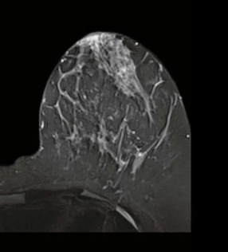
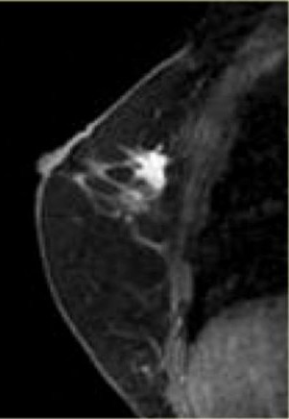
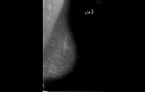
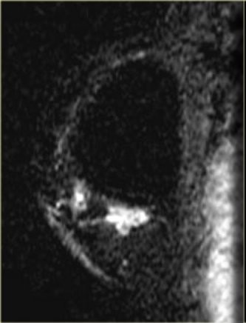
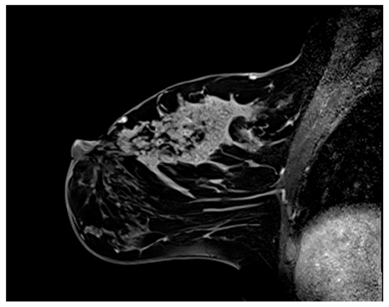
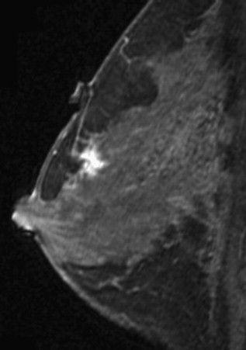
Database
SYSTEM DESIGN & IMPLEMENTATION
Dataset Used
Manually collected: Curated Breast Imaging Subset from KMCH.
Contains segregated mammogram images.
Software Stack
Python | TensorFlow | Keras | Flask | OpenCV | NumPy | Pandas | Scikit-learn |
Grad-CAM | LIME
MALIGNANT BENIGN

Slide 6
Database
SYSTEM DESIGN & IMPLEMENTATION(MODULES)
Dataset & Data Acquisition: CBIS-DDSM mammogram dataset with benign and malignant labels
Data Preprocessing: Noise removal, enhancement, segmentation, normalization
CNN Classification Module: Deep learning-based benign/malignant prediction
Explainable AI Module: Grad-CAM and LIME for transparent decision explanations
Clinical Decision Support Module: Assists radiologists with interpretable AI outputs
Nutrition & Dietetics Support Module: Post-diagnosis dietary guidance for patient well-being
Web-Based User Interface: Flask-based system for image upload and result visualization

Slide 7
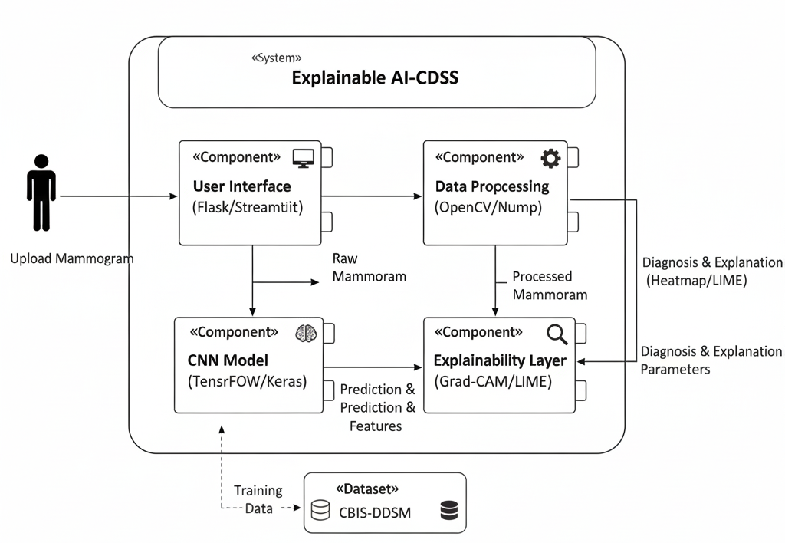
Database
MODEL ARCHITECTURE
UML Component Diagram
Raw
Mammogram
Processed
Mammogram
Tensorflow/Keras
Prediction & Features

Slide 8
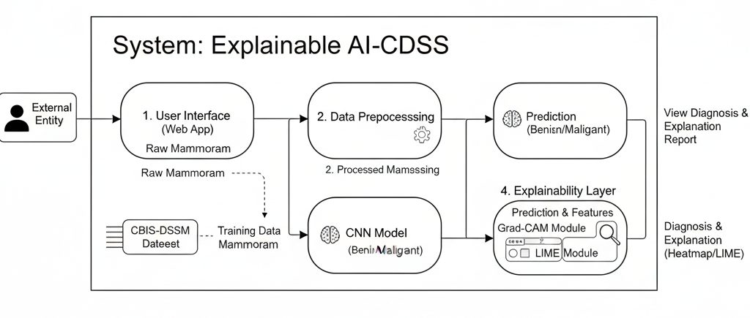
Database
DATA FLOW STRUCTURE
Prediction
(Benign/Malignant
Raw Mammogram
Training Data
Mammogram
Benign/Malignant

Slide 9
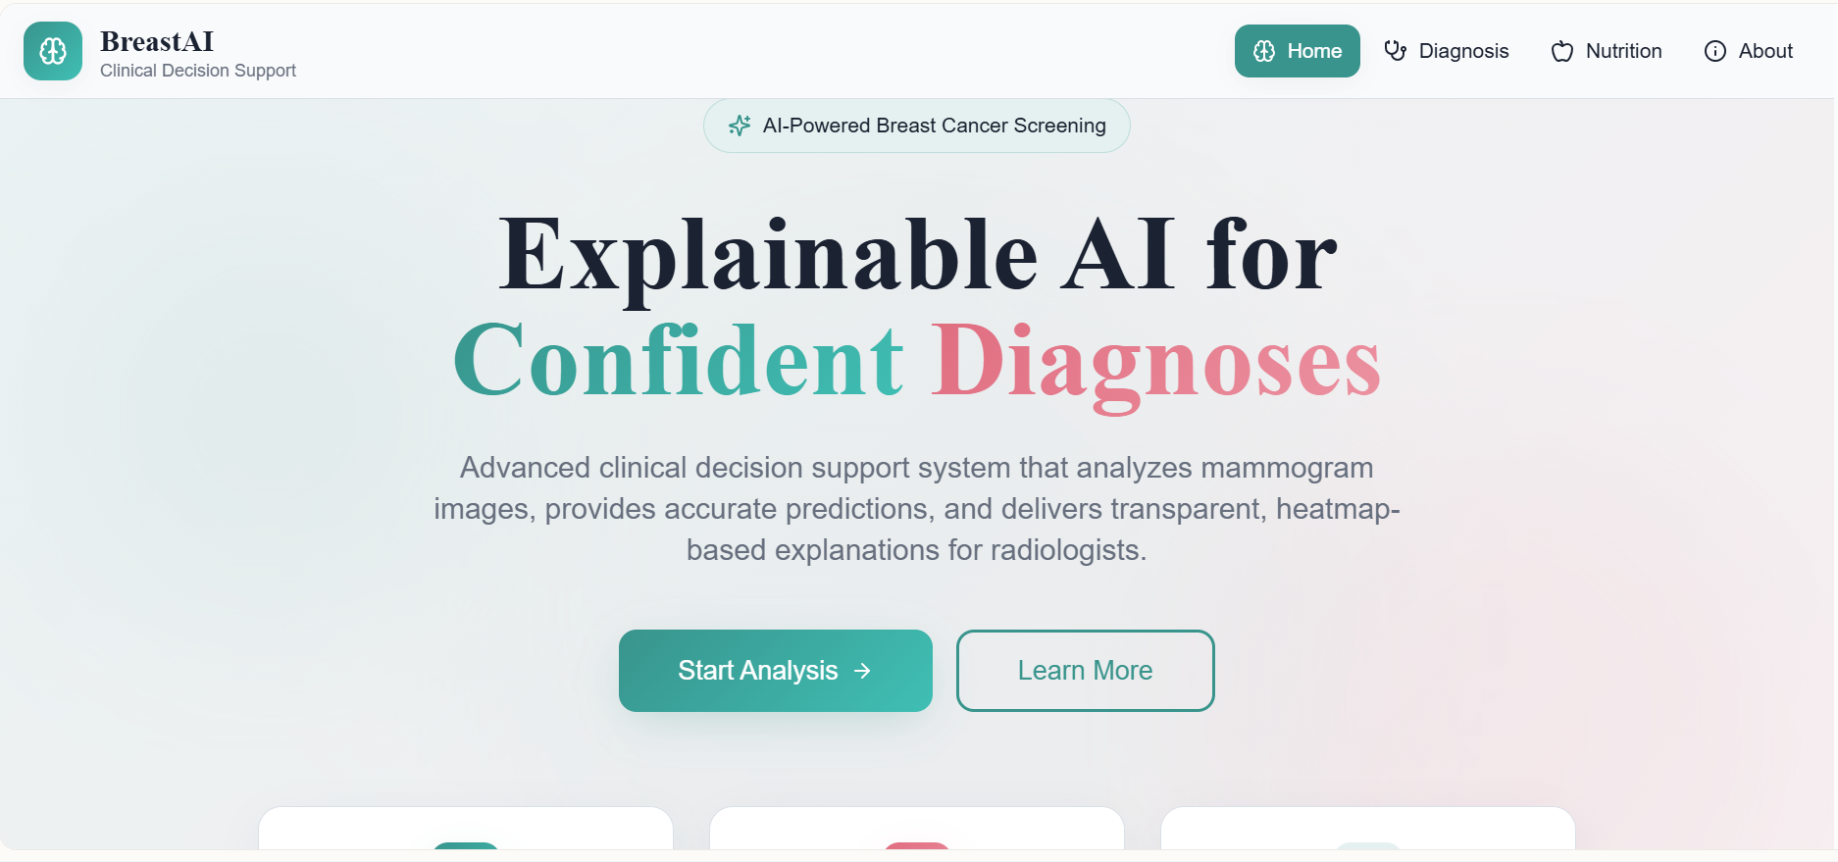
Database
FINAL OUTPUT – WEBSITE (HOMEPAGE)

Slide 10
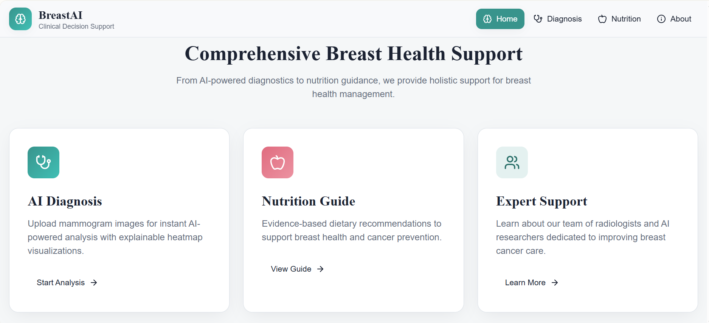
Database
HOME PAGE

Slide 11
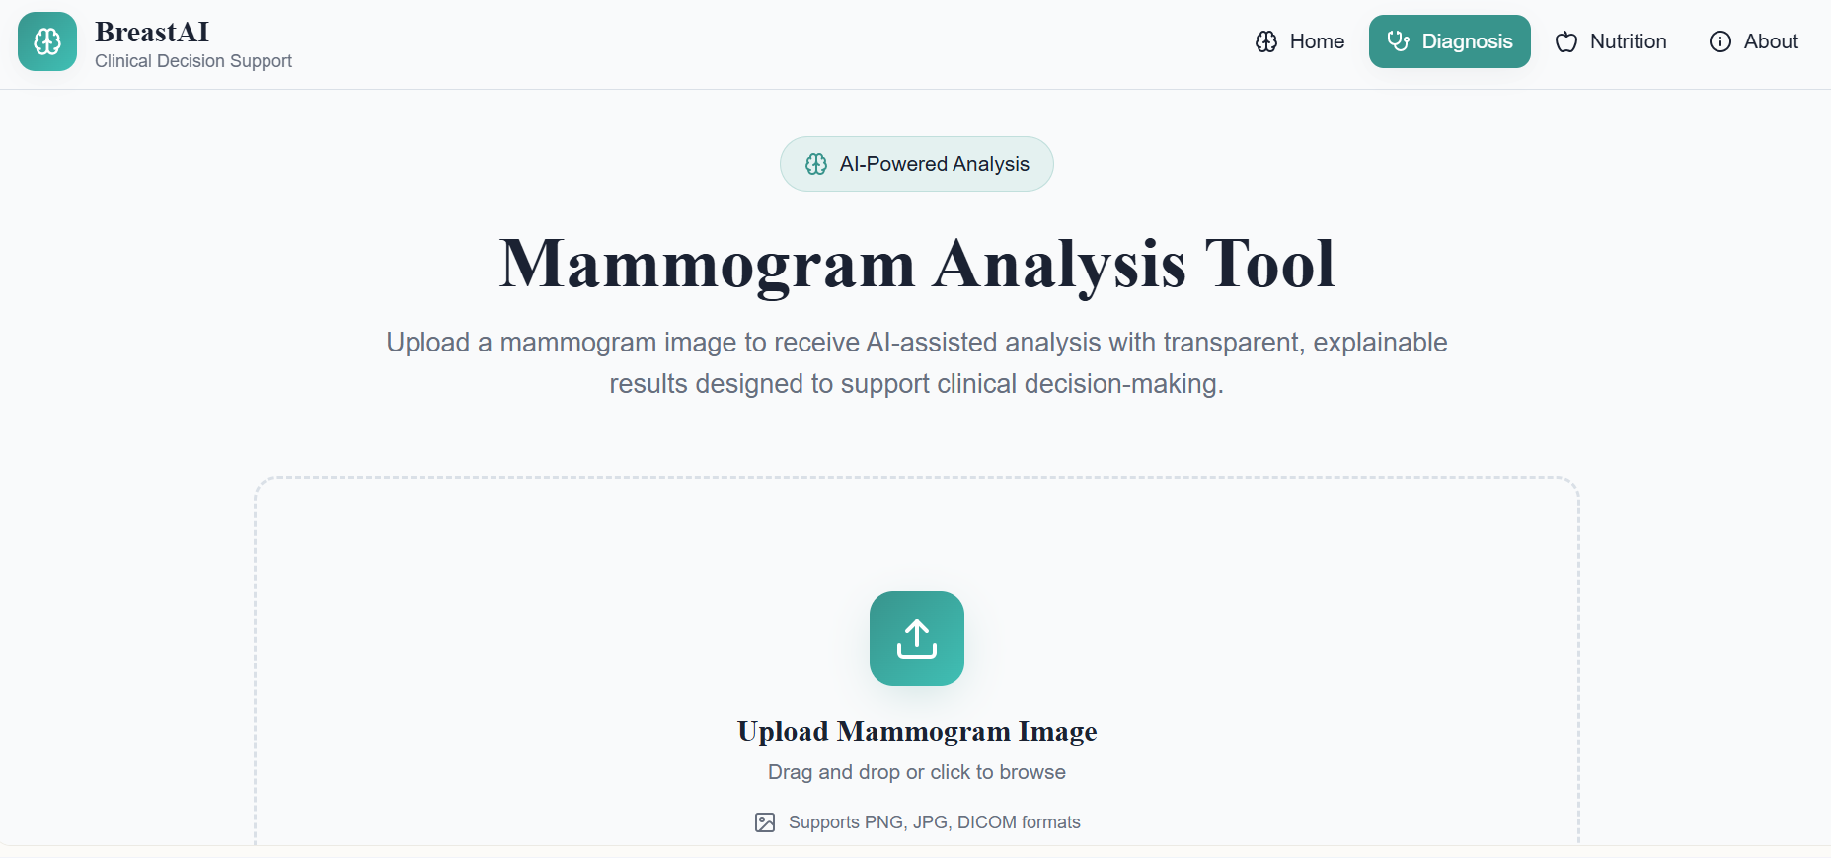
Database
DIAGNOSIS SECTION

Slide 12
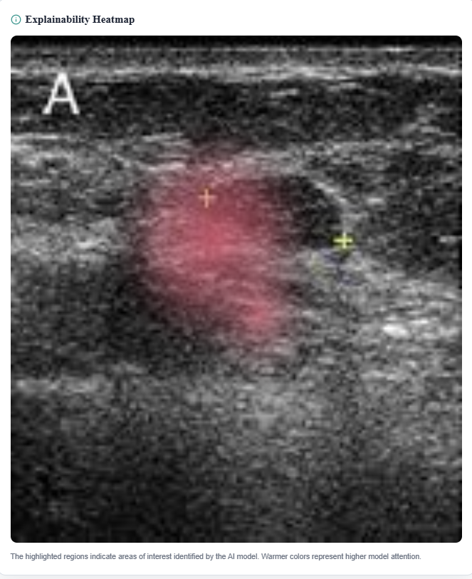
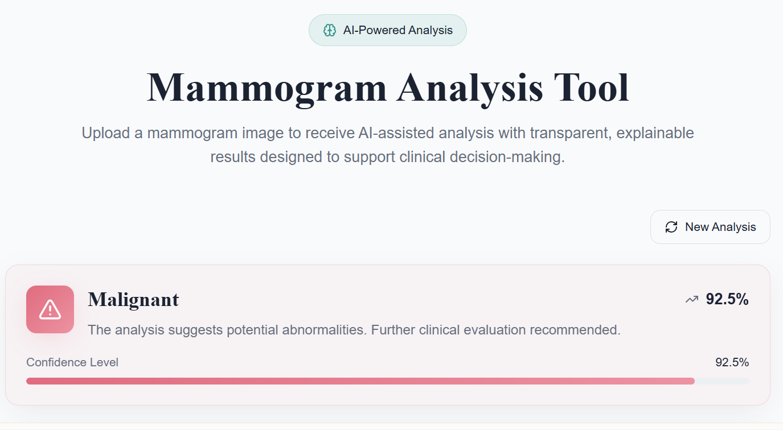
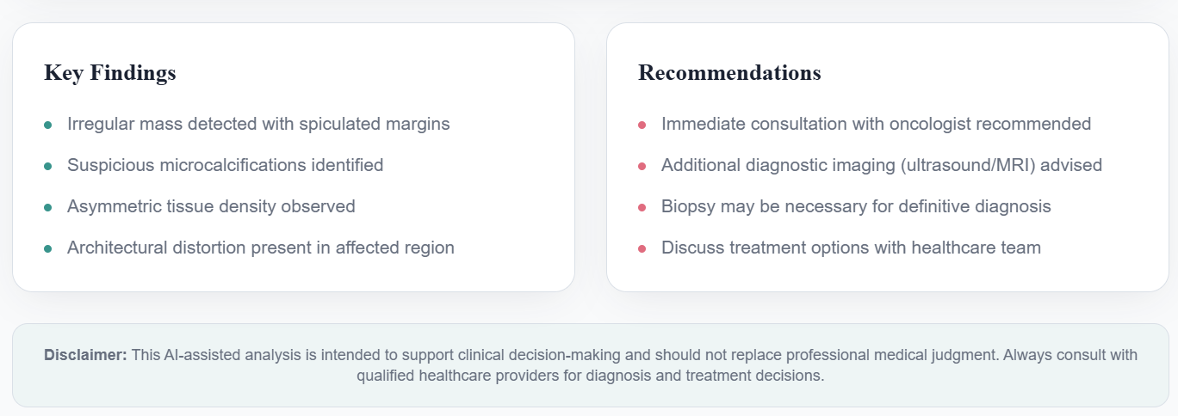
Database
DIAGNOSIS – ANALYSIS RESULTS (MALIGNANT)

Slide 13
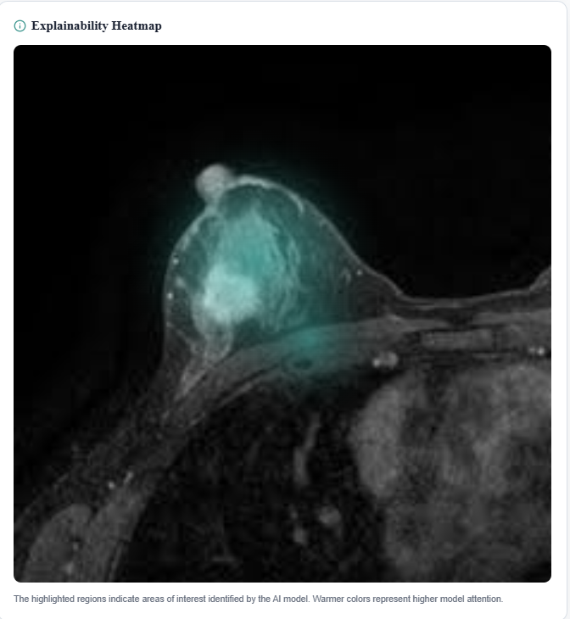
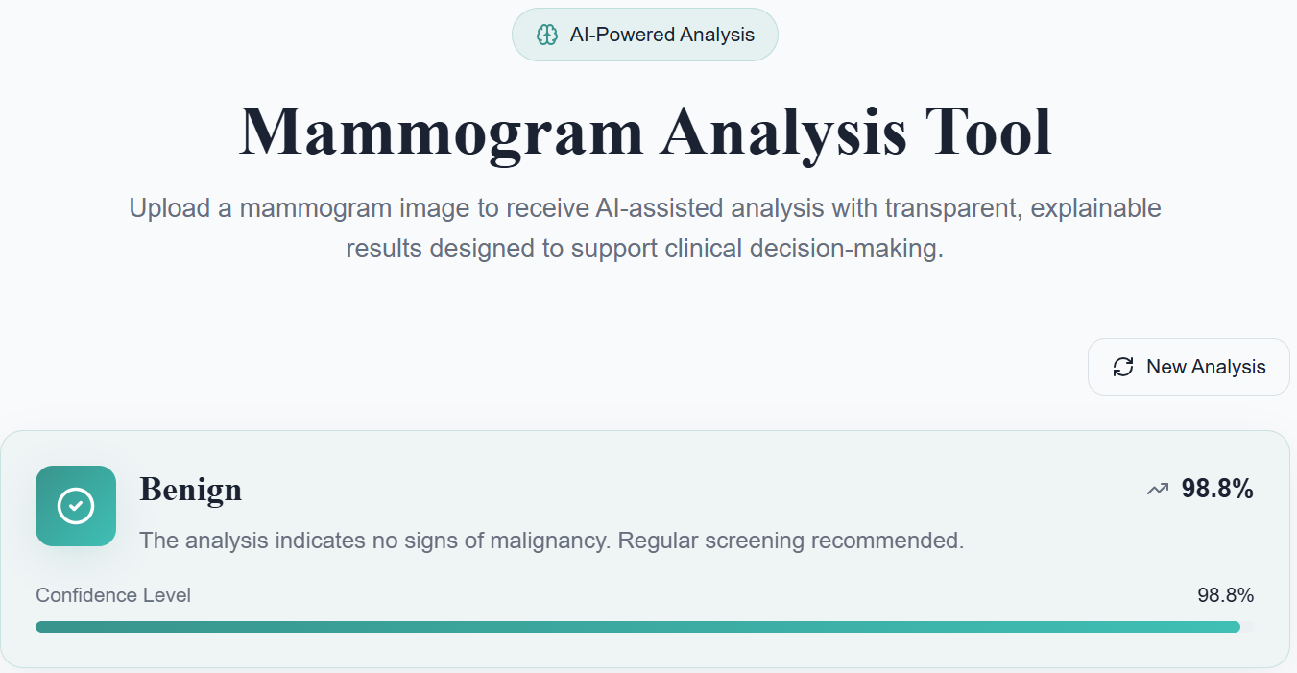
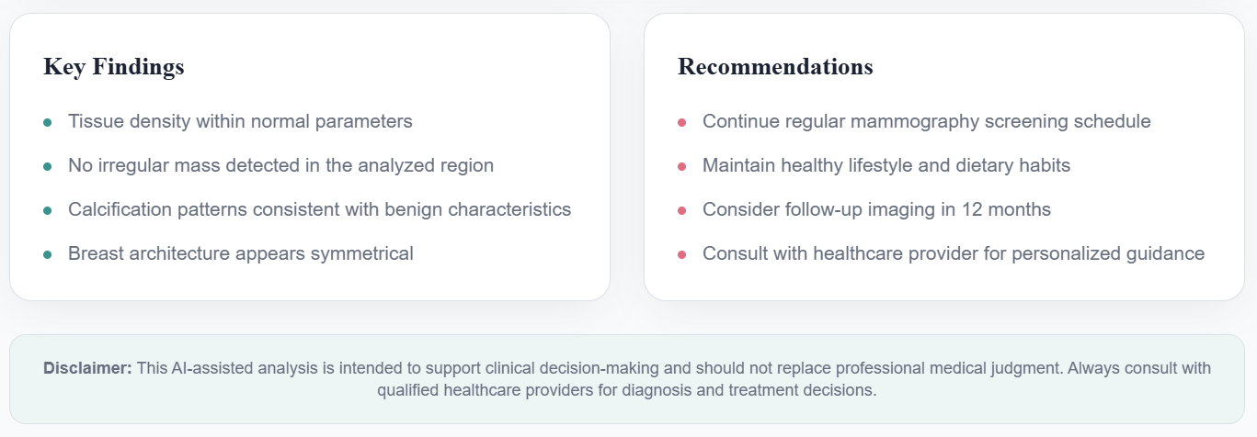
Database
DIAGNOSIS – ANALYSIS RESULTS (BENIGN)

Slide 14
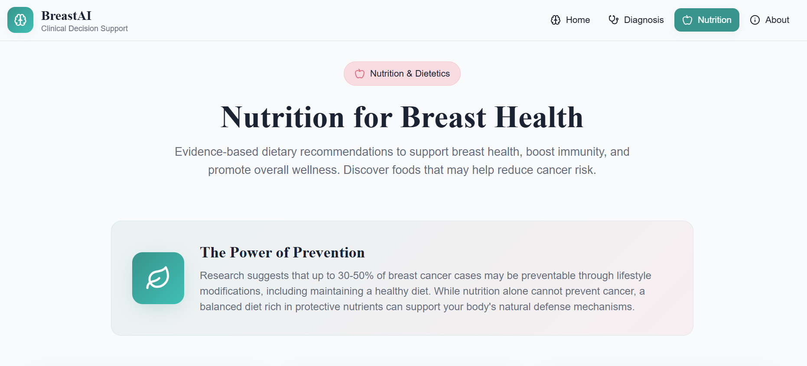
Database
NUTRITION SECTION

Slide 15
Database
FUTURE ENHANCEMENT
Patient-Level Diagnosis: Instead of single-image predictions, multiple mammogram views (CC and MLO of both breasts) can be combined to generate a comprehensive patient-level diagnosis.
Integration with DICOM Standards: Future versions can support DICOM format images, enabling direct integration with hospital Picture Archiving and Communication Systems (PACS).
3D and Multimodal Imaging Support: The system can be expanded to analyze additional imaging modalities such as ultrasound and MRI along with mammograms for enhanced diagnosis.
Clinical Validation and Expert Feedback: Incorporating radiologist feedback and clinical trials can help refine model predictions and improve real-world applicability.
Real-Time Deployment and Cloud Integration: Deploying the system on cloud platforms would allow real-time access, scalability, and remote usage in hospitals and diagnostic centers.

Slide 16



